Slide 1

Fulcrum – Marketing Strategy & Trade Show Support
Client Need
Fulcrum Technologies was looking to partner with a marketing firm to provide guidance and strategic planning for an upcoming trade show as well as overall marketing tactics to encourage growth. They had a limited budget, limited marketing tools, an unused contact list and did not have a booth at the event, so Affirma was faced with a challenge to come up with a plan to increase engagement and interaction with leads and/or customers who were attending the event.
What We Did
Affirma recommended a happy hour with associated campaign components to enable the Fulcrum team to network with prospects and clients who were attending the show. Primary goals included happy hour attendance, increased brand recognition and improved online visibility. Affirma set up the necessary marketing infrastructure to support the event, which included building a fully branded landing page for RSVP’s; configuring an email platform that integrated with the page and Fulcrum’s email sending domain; verifying Fulcrum’s cold contact list to protect their email sending reputation; and refreshing/optimizing their existing social media platforms.
Results
Fulcrum now has a built out marketing infrastructure they can continue to use for ongoing marketing efforts. The rebranded and updated social platforms helped increase activity and brand visibility across all channels, specifically Facebook, which received a 90% increase in organic page views! The email campaign had an average of 92% delivery rate with low unsubscribes/bounces. Best of all, there were 14 marketing qualified leads/contacts that attended the happy hour. Fulcrum was incredibly pleased with the results and the fact that they had a partner who was willing to not just do the work for them, but also teach them the necessary skills to perform successful marketing campaigns into the future.

Slide 2
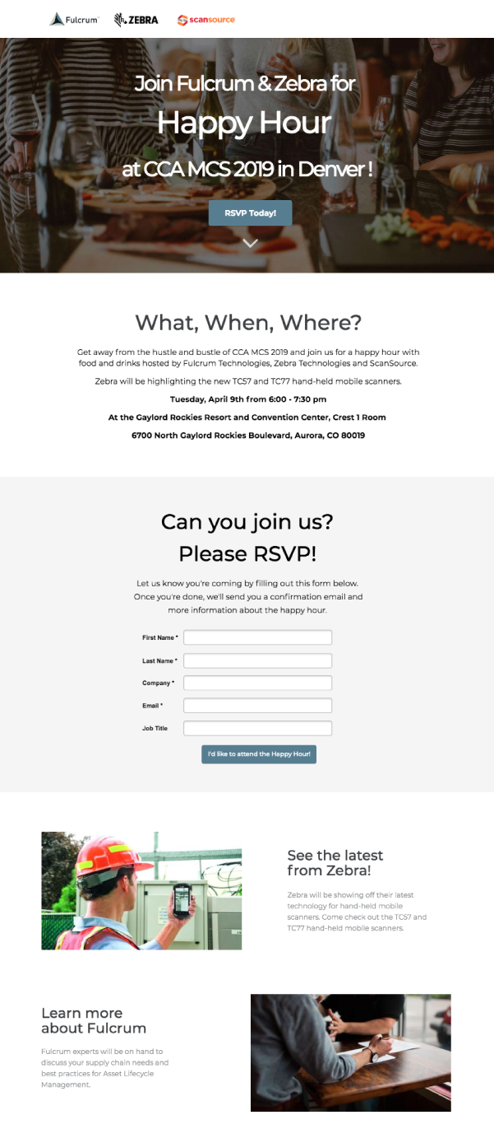
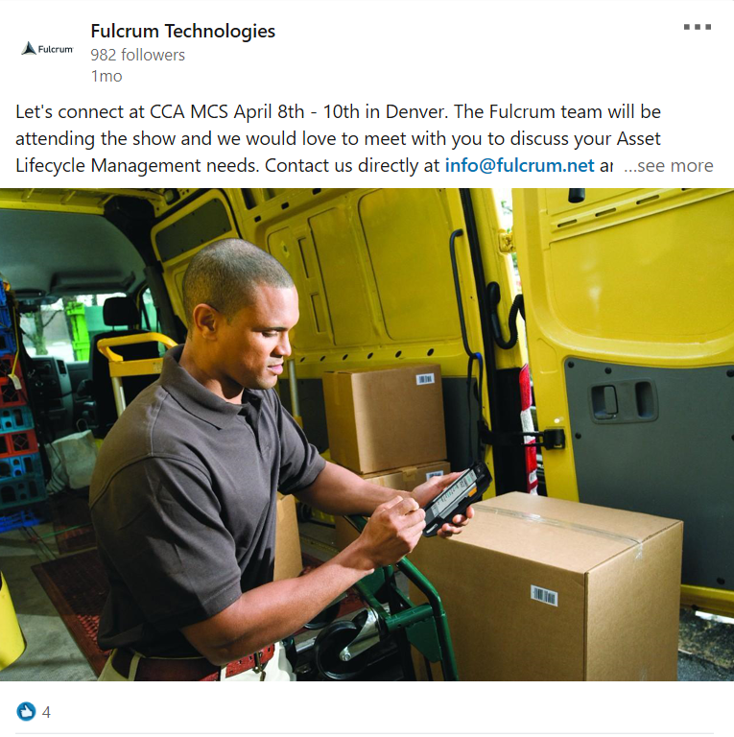
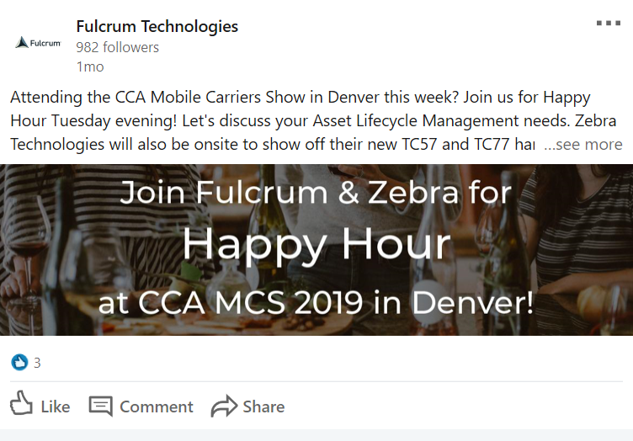
Fulcrum – Marketing Strategy & Trade Show Support
“The Affirma team has been really great to work with. They not only helped us roll out a successful marketing campaign, but they also taught us best practices and techniques that are unique to our business and set us up with tools we can use in the future. It was nice to have a vendor who didn’t just do the work for us, but who took the time to ensure we could learn along with them.”
- Isles Wallace, Software Architect

